Slide 1
Kleene’s Theorem
Shakir Ullah Shah
Lecture 7

Slide 2
Proof of Part 3: Converting Regular Expressions into FAs
We prove this part by recursive definition and constructive algorithm at the same time.
The set of regular expressions is defined by the following rules:
Rule 1: Every letter of the alphabet ∑ is a regular expression, Λ itself is a regular expression.
Rule 2: If r₁ and r₂ are regular expressions, then so are:
(i) (r₁)
(ii) r₁ + r₂
(iii) r₁ r₂
(iv) r₁*
Rule 3: Nothing else is a regular expression.

Slide 3
Rule 1
There is an FA that accepts any particular letter of the alphabet.
There is an FA that accepts only the word Λ.

Slide 4
Proof of rule 1
If letter x is in ∑, then the following FA accepts only the word x.
The following FA accepts only : Λ

Slide 5
Rule 2
If there is an FA called FA₁ that accepts the language defined by the regular expression r₁, i.e. L(FA₁)= r₁ and
there is an FA called FA₂ that accepts the language defined by the regular expression r₂, i.e. L(FA₂₎=r₂
then there is an FA that we shall call FA₃ that accepts the language defined by the regular expression (r₁ + r₂) i.e. L(FA₃)= (r₁ + r₂)

Slide 6
Proof of Rule 2
We shall show that FA₃ exists by presenting an algorithm showing how to construct FA₃.
Algorithm:
– Starting with two machines, FA₁ with states x₁; x₂; x₃;…, and FA₂ with states y₁; y₂; y₃; …, we construct a new machine FA₃ with states z₁; z₂; z₃; … where each z_{i} is of the form x_{something} or y_{something}.
– The combination state x_{start} or y_{start} is the start state of the new machine FA₃.
– If either the x part or the y part is a final state, then the corresponding z is a final state.

Slide 7
Algorithm (cont.)
– To go from one state z to another by reading a letter from the input string, we observe what happens to the x part and what happens to the y part and go to the new state z accordingly. We could write this as a formula:
z_{new} after reading letter p = (x_{new} after reading letter p on FA₁) or (y_{new} after reading letter p on FA₂)

Slide 8
Remarks
The new machine FA₃ constructed by the above algorithm will simultaneously keep track of where the input would be if it were running on FA₁ alone, and where the input would be if it were running on FA₂ alone.
If a string traces through the new machine FA₃ and ends up at a final state, it means that it would also end at a final state either on machine FA₁ or on machine FA₂. Also, any string accepted by either FA₁ or FA₂ will be accepted by this FA₃. So, the language FA₃ accepts is the union of the languages accepted by FA₁ and FA₂, respectively.
Note that since there are only finitely many states x’s and finitely many states y’s, there can be only finitely many possible states z’s.
Let us look at an example illustrating how the algorithm works.

Slide 9
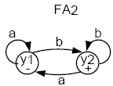
Example
Consider the following two FAs:
FA₁ accepts all words with a double a in them.
FA₂ accepts all words ending with b.
Let’s follow the algorithm to build FA₃ that accepts the union of the two languages.

Slide 10
Combining the FAs
The start (-) state of FA₃ is z₁ = x₁ or y₁.
In z₁, if we read an a, we go to x₂ (observing FA₁), or we go to y₁ (observing FA₂).
Let z₂ = x₂ or y₁.
In z₁, if we read a b, we go to x₁ (observing FA₁), or to y₂ (observing FA₂).
Let z₃ = x₁ or y₂. Note that z₃ must be a final state since y₂ is a final state.
Old states | New states after reading
 | a | b
z₁– € (x₁,y₁) | (x₂,y₁) € z₂ | (x₁,y₂) € z₃

Slide 11
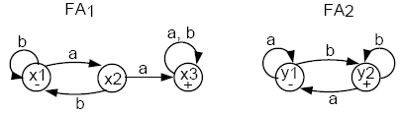
In z₂, if we read an a, we go to x₃ or y₁. Let z₄ = x₃ or y₁. z₄ is a final state because x₃ is.
In z₂, if we read a b, we go to x₁ or y₂, which is z₃.
Old states | New states after reading
 | a | b
z₁– € (x₁,y₁) | (x₂,y₁) € z₂ | (x₁,y₂) € z₃
z₂ € (x₂, y₁) | (x₃, y₁) € z₄ | (x₁, y₂) € z₃

Slide 12
Old states | New states after reading
 | a | b
z₁– € (x₁,y₁) | (x₂,y₁) € z₂ | (x₁,y₂) € z₃
z₂ € (x₂, y₁) | (x₃, y₁) € z₄ | (x₁, y₂) € z₃
z₃ + € (x₁, y₂) | (x₂, y₁) € z₂ | (x₁, y₂) € z₃
z₄ + € (x₃, y₁) | (x₃, y₁) € z₄ | (x₃, y₂) € z₅
z₅ + € (x₃, y₂) | (x₃, y₁) € z₄ | (x₃, y₂) € z₅

Slide 13
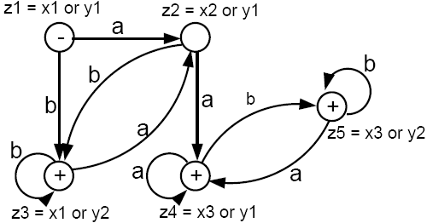
Old states | New states after reading
 | a | b
z₁– € (x₁,y₁) | (x₂,y₁) € z₂ | (x₁,y₂) € z₃
z₂ € (x₂, y₁) | (x₃, y₁) € z₄ | (x₁, y₂) € z₃
z₃ + € (x₁, y₂) | (x₂, y₁) € z₂ | (x₁, y₂) € z₃
z₄ + € (x₃, y₁) | (x₃, y₁) € z₄ | (x₃, y₂) € z₅
z₅ + € (x₃, y₂) | (x₃, y₁) € z₄ | (x₃, y₂) € z₅

Slide 14
This machine accepts all words that have a double a or that end with b.
The labels z₁ = x₁ or y₁, z₂ = x₂ or y₁, etc. can be removed if you want.
RE corresponding to the above FA may be
r1+r2 = (a+b)*b + (a+b )*aa(a+b )*

Slide 15
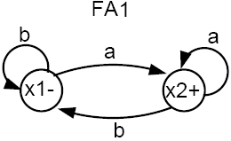
Example
Let r₁=(a+b)*a (words that end in a) and the corresponding FA₁ be

Slide 16
Example
Let r₁=(a+b)*a (words that end in a) and the corresponding FA₁ be
Let r₂ = (a+b)( (a+b)(a+b) )* or (a+b)(a+b) )*(a+b) (words of odd length) and FA₂ be

Slide 17
Example
Let r₁=(a+b)*a (words that end in a) and the corresponding FA₁ be
Let r₂ = (a+b)( (a+b)(a+b) )* or (a+b)(a+b) )*(a+b) (words of odd length) and FA₂ be
Task:
Generate Union of FAs corresponding to r1 and r2 i.e.
r1+ r2

Slide 18
Rule 3
If there is an FA₁ that accepts the language defined by the regular expression r₁, and
there is an FA₂ that accepts the language defined by the regular expression r₂,
then there is an FA₃ that accepts the language defined by the (concatenation) regular expression (r₁r₂), i.e. the product language.

Slide 19
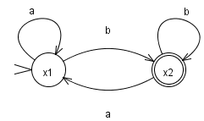
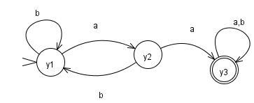
Example
Let r₁ =(a+b)*b defines L₁ and FA₁ be
and r₂ = (a+b )*aa (a+b )* defines L₂ and FA₂ be

Slide 20
Concatenation of two FAs Continued …
Let FA₃ be an FA corresponding to r₁r₂ , then the initial state of FA₃ must correspond to the initial state of FA₁ and the final state of FA₃ must correspond to the final state of FA₂ . Since the language corresponding to r₁r₂ is the concatenation of corresponding languages L₁ and L₂ , consists of the strings obtained, concatenating the strings of L₁ to those of L₂ , therefore the moment a final state of FA₁ is entered, the possibility of the initial state of FA₂will be included as well.

Slide 21
Concatenation of two FAs Continued …
Since, in general, FA₃ will be different from both FA₁ and FA₂ , so the labels of the states of FA₃ may be supposed to be z₁,z₂, z₃, …, where z₁ stands for the initial state. Since z₁ corresponds to the states x₁ , so there will be two transitions separately for each letter read at z₁ . It will give two possibilities of states which correspond to either z₁ or different from z₁ . This process may be expressed in the following transition table for all possible states of FA₃

Slide 22
Example continued …
Old states | New states after reading
 | a | b
z₁– € x₁ | x₁ € z₁ | (x₂,y₁) € z₂

Slide 23
Example continued …
Old states | New states after reading
 | a | b
z₁– € x₁ | x₁ € z₁ | (x₂,y₁) € z₂
z₂ € (x₂, y₁) | (x₁, y₂) € z₃ | (x₂, y₁) € z₂
z₃ € (x₁, y₂) | (x₁, y₃) € z₄ | (x₂, y₁) € z₂
z₄ + € (x₁, y₃) | (x₁, y₃) € z₄ | (x₂, y₁, y₃) € z₅
z₅ + € (x₂, y₁, y₃) | (x₁, y₂, y₃) € z₆ | (x₂, y₁, y₃) € z₅
z₆ + € (x₁, y₂, y₃) | (x₁, y₃) € z₄ | (x₂, y₁, y₃) € z₅

Slide 24
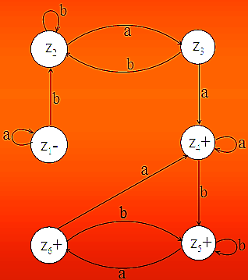

Slide 25
Example
Let r₁ =b(a+b)* , the corresponding FA₁ be
also r₂ = (a+b)*b
Task:
Generate the FA representing r1 r2 using Concatenation Algorithm

Slide 26
Kleene’s Theorem Part 3 …
Closure of an FA
If r is a regular expression and FA₁ is a finite automaton that accepts exactly the language defined by r, then there is an FA, called FA₂, that will accepts exactly the language defined by r *.

Slide 27
Kleene’s Theorem Part 3 …
Closure of an FA
Closure of an FA, is same as concatenation of an FA with itself, except that
the initial state of the required FA is a final state as well (because Λ is also accepted in closure).
non final state of the required FA as well.
Means initial state of given FA will correspond to two sates in required FA.

Slide 28
Example
Consider the regular expression r = aa*bb*.

Slide 29
Example
Consider the regular expression r = aa*bb*.
This defines the language where all the a’s come before all the b’s.
The FA that accepts this language is:

Slide 30
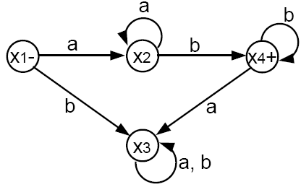
Example
Consider the regular expression r = aa*bb*.
This defines the language where all the a’s come before all the b’s.
The FA that accepts this language is:

Slide 31
Example
Let us now build FA₂ that accepts r* = (aa*bb*)*.
We begin with the start state z₁ = x₁.
In z₁, reading an a takes us to x₂ = z₂. Reading a b takes us to x₃ = z₃.
Old states | New states after reading
 | a | b
z₁– +=x₁ | X₂= z₂ | x₃= z₃

Slide 32
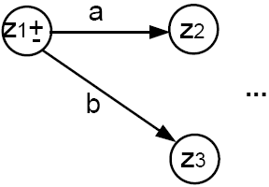
Example
Let us now build FA₂ that accepts r* = (aa*bb*)*.
We begin with the start state z₁ = x₁.
In z₁, reading an a takes us to x₂ = z₂. Reading a b takes us to x₃ = z₃.
Old states | New states after reading
 | a | b
z₁– +=x₁ | X₂= z₂ | x₃= z₃

Slide 33
Example
In z₂, if we read an a we go back to z₂. If we read a b, we go to x₄ , or we have the option of jumping to the start state x₁ (since x₄ is a final state). Hence, let z₄ += x₄ or x₁.
In z₃, just like x₃, reading either an a or a b, we loop back to z₃.
Old states | New states after reading
 | a | b
z₁– +=x₁ | x₂= z₂ | x₃= z₃
z₂=x₂ | x₂= z₂ | X₁₌z₄+ X₄₌z₄+
z₃=x₃ | x₃= z₃ | x₃= z₃

Slide 34
Example
In z₂, if we read an a we go back to z₂. If we read a b, we go to x₄ , or we have the option of jumping to the start state x₁ (since x₄ is a final state). Hence, let z₄ += x₄ or x₁.
In z₃, just like x₃, reading either an a or a b, we loop back to z₃.
Old states | New states after reading
 | a | b
z₁– +=x₁ | x₂= z₂ | x₃= z₃
z₂=x₂ | x₂= z₂ | X₁₌z₄+ X₄₌z₄+
z₃=x₃ | x₃= z₃ | x₃= z₃

Slide 35
Example
Old states | New states after reading
 | a | b
z₁– +=x₁ | x₂= z₂ | x₃= z₃
z₂=x₂ | x₂= z₂ | X₁₌z₄+ X₄₌z₄+
z₃=x₃ | x₃= z₃ | x₃= z₃

Slide 36
Example
Old states | New states after reading
 | a | b
z₁– +=x₁ | x₂= z₂ | x₃= z₃
z₂=x₂ | x₂= z₂ | X₁₌z₄+ X₄₌z₄+
z₃=x₃ | x₃= z₃ | x₃= z₃
z₄+=x₁ z₄+=x₄ | x₂= z₂ x₃= z₃ (x₂,x₃)= z₅ | x₃= z₃ x₄= z₄ x₁= z₁ (x₃,x_{4,}x₁)= z₆
In z₄, what happens if we read an a? If z₄ = x₁, we go to x₂. If z₄ = x₄, we go to x₃. Hence, we will be in x₂ or x₃. So, let z₅ = x₂ or x₃.
In z₄, if we read a b? If z₄ means x₁, we go x₃. If z₄ means x₄, we go to x₄ or jump to x₁ (due to final x₄). Thus, let z₆ = x₁ or x₃ or x₄. z₆ must be a final state since x₄ is.

Slide 37
Example
Old states | New states after reading
 | a | b
z₁– +=x₁ | x₂= z₂ | x₃= z₃
z₂=x₂ | x₂= z₂ | X₁₌z₄+ X₄₌z₄+
z₃=x₃ | x₃= z₃ | x₃= z₃
z₄+=x₁ z₄+=x₄ | x₂= z₂ x₃= z₃ (x₂,x₃)= z₅ | x₃= z₃ x₄= z₄ x₁= z₁ (x₃,x_{4,}x₁)= z₆
z₅=(x₂,x₃) | (x₂,x₃)= z₅ | (x₄,x_{1,}x₃)= z₆
In z5, reading an a takes us to x2 or x3, which is still z5. So, we have an a-loop at z5.
In z5, reading a b takes us to x4 or x1, or x3, which is z6.

Slide 38
Example
Old states | New states after reading
 | a | b
z₁– +=x₁ | x₂= z₂ | x₃= z₃
z₂=x₂ | x₂= z₂ | X₁₌z₄+ X₄₌z₄+
z₃=x₃ | x₃= z₃ | x₃= z₃
z₄+=x₁ z₄+=x₄ | x₂= z₂ x₃= z₃ (x₂,x₃)= z₅ | x₃= z₃ x₄= z₄ x₁= z₁ (x₃,x_{4,}x₁)= z₆
z₅=(x₂,x₃) | (x₂,x₃)= z₅ | (x₄,x_{1,}x₃)= z₆
z₆=(x₄,x_{1,}x₃) | (x₂,x₃)= z₅ | (x₄,x_{1,}x₃)= z₆
In z6, reading an a, take us to x2 or x3, which is z5.
In z6, reading a b takes us to x3, x4, or x1, which is still z6. So, we have a b-loop at z6.

Slide 39
Example
Old states | New states after reading
 | a | b
z₁– +=x₁ | x₂= z₂ | x₃= z₃
z₂=x₂ | x₂= z₂ | X₁₌z₄+ X₄₌z₄+
z₃=x₃ | x₃= z₃ | x₃= z₃
z₄+=x₁ z₄+=x₄ | x₂= z₂ x₃= z₃ (x₂,x₃)= z₅ | x₃= z₃ x₄= z₄ x₁= z₁ (x₃,x_{4,}x₁)= z₆
z₅=(x₂,x₃) | (x₂,x₃)= z₅ | (x₄,x_{1,}x₃)= z₆
z₆=(x₄,x_{1,}x₃) | (x₂,x₃)= z₅ | (x₄,x_{1,}x₃)= z₆

Slide 40
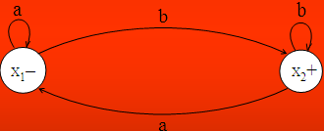
Example
Let r=(a+b)*b and the corresponding FA be
then the FA corresponding to r* may be determined as under

Slide 41
Example
In this case we need to represent x₁ as two separate z-states in FA₂,
one as a start and final state ± (z1 ± = x1), and the other as
the non-final start state (z2 = x1) .
The ± state is necessary for FA₂ to accept .
The non-final start state is necessary for FA₂ to operate correctly, since some strings that return to the start state x₁ may not be valid words and therefore should not be accepted.

Slide 42
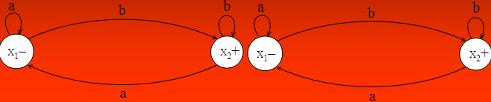
Example
Old states | New states after reading
 | a | b
z₁ - + ≡ x₁ | Non-final x₁ ≡ z₂ | (x₂, x₁) ≡ z₃

Slide 43
Example
Old states | New states after reading
 | a | b
z₁ - + ≡ x₁ | Non-final x₁ ≡ z₂ | (x₂, x₁) ≡ z₃
Non-final z₂ ≡ x₁ | x₁ ≡ z₂ | (x₂, x₁) ≡ z₃

Slide 44
Example
Old states | New states after reading
 | a | b
z₁ - + ≡ x₁ | Non-final x₁ ≡ z₂ | (x₂, x₁) ≡ z₃
Non-final z₂ ≡ x₁ | x₁ ≡ z₂ | (x₂, x₁) ≡ z₃
z₃ + ≡ (x₂, x₁) | x₁ ≡ z₂ | (x₂, x₁) ≡ z₃

Slide 45
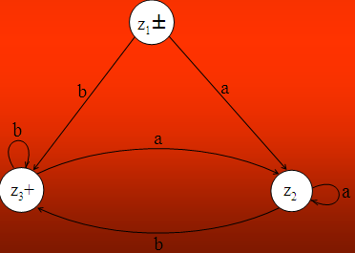
Example
Old states | New states after reading
 | a | b
z₁ - + ≡ x₁ | Non-final x₁ ≡ z₂ | (x₂, x₁) ≡ z₃
Non-final z₂ ≡ x₁ | x₁ ≡ z₂ | (x₂, x₁) ≡ z₃
z₃ + ≡ (x₂, x₁) | x₁ ≡ z₂ | (x₂, x₁) ≡ z₃

Slide 46
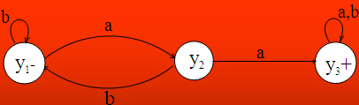
Example
Let r=(a+b)*aa(a+b)* and the corresponding FA be

Slide 47
Example
Old states | New states after reading
 | a | b
z₁ - + ≡ y₁ | y₂ ≡ z₃ | y₁ ≡ z₂

Slide 48
Example
Old states | New states after reading
 | a | b
z₁ - + ≡ y₁ | y₂ ≡ z₃ | y₁ ≡ z₂
z₂≡ y₁ | y₂≡ z₃ | y₁≡ z₂

Slide 49
Example
Old states | New states after reading
 | a | b
z₁ - + ≡ y₁ | y₂ ≡ z₃ | y₁ ≡ z₂
z₂≡ y₁ | y₂≡ z₃ | y₁≡ z₂
z₃≡ y₂ | (y₃,y₁) ≡ z₄ | y₁≡ z₂

Slide 50
Example
Old states | New states after reading
 | a | b
z₁ - + ≡ y₁ | y₂ ≡ z₃ | y₁ ≡ z₂
z₂≡ y₁ | y₂≡ z₃ | y₁≡ z₂
z₃≡ y₂ | (y₃,y₁) ≡ z₄ | y₁≡ z₂
z₄⁺≡ (y₃, y₁) | (y₃ , y₁, y₂) ≡ z₅ | (y₃, y₁) ≡ z₄

Slide 51
Example
Old states | New states after reading
 | a | b
z₁ - + ≡ y₁ | y₂ ≡ z₃ | y₁ ≡ z₂
z₂≡ y₁ | y₂≡ z₃ | y₁≡ z₂
z₃≡ y₂ | (y₃,y₁) ≡ z₄ | y₁≡ z₂
z₄⁺≡ (y₃, y₁) | (y₃ , y₁, y₂) ≡ z₅ | (y₃, y₁) ≡ z₄
z₅⁺ ≡ (y₃, y₁, y₂) | (y₃, y₁ , y₂) ≡ z₅ | (y₃, y₁) ≡ z₄

Slide 52
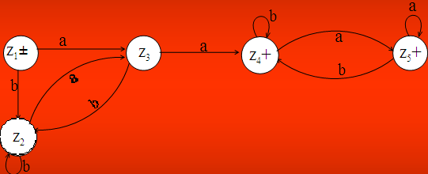
Example

Slide 53
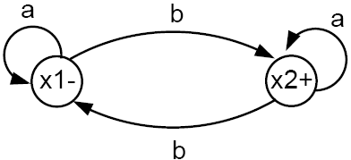
Task
Consider the FA below that accepts the language of all words having an odd number of b’s.
Generate (FA)* from above FA

Slide 54
Proof
We have finished the proof of part 3 of Kleene’s theorem.
Notes:
P106028

Slide 55
Proof
We have finished the proof of part 3 of Kleene’s theorem.
Because of Rules 1, 2, 3, and 4, we know that all regular expressions have corresponding finite automata that define the same language.

Slide 56
Proof
We have finished the proof of part 3 of Kleene’s theorem.
Because of Rules 1, 2, 3, and 4, we know that all regular expressions have corresponding finite automata that define the same language.
This is because while we are constructing the regular expression from elementary building blocks using recursive definition, we can simultaneously be constructing the corresponding FA using the algorithms discussed.

Slide 57
Nondeterministic Finite Automaton (NFA)
Notes:
Faizullah: 03155454120
03329361911
40000
7 2500
3 3000*3
(16000)
8 marla 172000

Slide 58
Nondeterministic Finite Automaton (NFA)
Definition: An NFA is a TG with a unique start state and a property of having single letter as label of transitions. An NFA is a collection of three things
1) Finite many states with one initial and some final states
2) Finite set of input letters, say, Σ ={a, b, c}
3) Finite set of transitions, showing where to move if a letter is input at certain state (Λ is not a valid transition), there may be more than one transition for certain letters and there may not be any transition for certain letters.

Slide 59
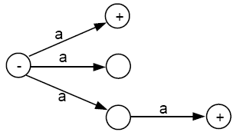
Examples of NFA

Slide 60
Examples of NFA
It is to be noted that the above NFA accepts the language consisting of a and aa.

Slide 61
Examples of NFA
It is to be noted that the above NFA accepts the language of strings, defined over Σ = {a, b}, containing aa.

Slide 62
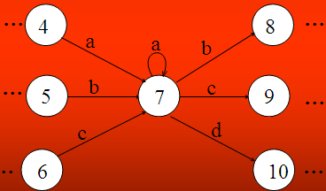
Examples of NFA
Consider a part of the following FA with an alphabet Σ={a,b,c,d}
To eliminate the loop at state 7, the corresponding NFA may be as follows

Slide 63
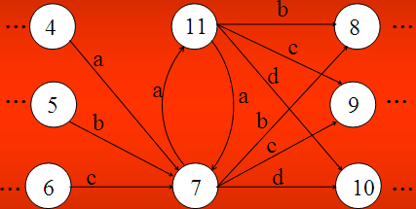
Examples of NFA

Slide 64
Theorem 7
for every NFA, there is some FA that accepts exactly the same language.

Slide 65
Theorem 7
for every NFA, there is some FA that accepts exactly the same language.
Proof 1

Slide 66
Theorem 7
for every NFA, there is some FA that accepts exactly the same language.
Proof 1
By the proof of part 2 of Kleene’s theorem, we can convert an NFA into a regular expression, since an NFA is a TG.

Slide 67
Theorem 7
for every NFA, there is some FA that accepts exactly the same language.
Proof 1
By the proof of part 2 of Kleene’s theorem, we can convert an NFA into a regular expression, since an NFA is a TG.
By the proof of part 3 of Kleene’s theorem, we can construct an FA that accepts the same language as the regular expression. Hence, for every

Slide 68
Theorem 7
for every NFA, there is some FA that accepts exactly the same language.
Proof 1
By the proof of part 2 of Kleene’s theorem, we can convert an NFA into a regular expression, since an NFA is a TG.
By the proof of part 3 of Kleene’s theorem, we can construct an FA that accepts the same language as the regular expression. Hence, for every
NFA, there is a corresponding FA.

Slide 69
Note
Theorem 7 means that all NFAs can be converted into FAs.
Clearly, all FAs can be considered as NFAs that do not make use of the option of extra freedom of edge production.
Hence, as language acceptors, NFA = FA.

Slide 70


Example
Consider the following FA corresponding to (a+b)*b
The above FA may be equivalent to the following NFA
Can the structure of above NFA be compared with the corresponding RE ?

Slide 71


Example
Consider the following FA
The above FA may be equivalent to the following NFA
Can the structure of above NFA be compared with the corresponding RE ?

Slide 72
Note
It is to be noted that every FA can be considered to be an NFA as well , but the converse may not true.
It may also be noted that every NFA can be considered to be a TG as well, but the converse may not true.
It may be observed that if the transition of null string is also allowed at any state of an NFA then what will be the behavior in the new structure. This structure is defined in the following

Slide 73
NFA with Null String
Definition: If in an NFA, Λ is allowed to be a label of an edge then the NFA is called NFA with Λ (NFA- Λ ). An NFA- Λ is a collection of three things
(1) Finite many states with one initial and some final states.
(2) Finite set of input letters, say, Σ ={a, b, c}.
(3) Finite set of transitions, showing where to move if a letter is input at certain state. There may be more than one transitions for certain letter and there may not be any transition for a certain letter. The transition of Λ is also allowed at any state.

Slide 74

Example
Consider the following NFA with Null string
The above NFA with Null string accepts the language of strings, defined over Σ = {a, b}, ending in b.

Slide 75

Example
Consider the following NFA with Null string
The above NFA with Null string accepts the language of strings, defined over Σ = {a, b}, ending in a.

Slide 76
Example
It is to be noted that every FA may be considered to be an NFA- Λ as well, but the converse may not true.
Similarly every NFA- Λ may be considered to be a TG as well, but the converse may not true.

Slide 77
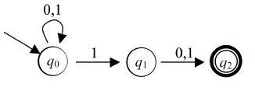
NFA to FA
For any NFA, there is a DFA that recognizes the same language
Proof is by construction: a DFA that keeps track of the set of states the NFA might be in
This is called the subset construction
First, an example starting from this NFA:

Slide 78
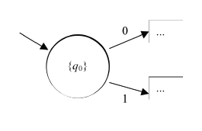
NFA to FA
• Initially, the set of states the NFA could be in
is just {q0}
• So our DFA will keep track of that using a start state labeled {q0}:

Slide 79
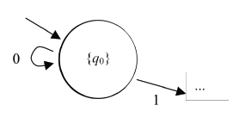
NFA to FA
• Now suppose the set of states the NFA could
be in is {q0}, and it reads a 0
• The set of possible states after reading the 0
is {q0}, so we can show that transition:

Slide 80
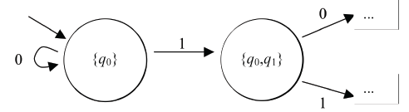
NFA to FA
• Suppose the set of states the NFA could be in
is {q0}, and it reads a 1
• The set of possible states after reading the 1
is {q0,q1}, so we need another state:

Slide 81
NFA to FA
• From {q0,q1} on a 0, the next set of possible
states is δ(q0,0) ∪ δ(q1,0) = {q0,q2}
• From {q0,q1} on a 1, the next set of possible
states is δ(q0,1) ∪ δ(q1,1) = {q0,q1,q2}
• Adding these transitions and states, we get…

Slide 82
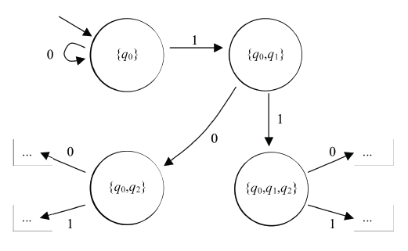
NFA to FA

Slide 83
NFA to FA
• Eventually, we find that no further states are
generated
• That's because there are only finitely many
possible sets of states: P(Q)
• In our example, we have already found all
sets of states reachable from {q0}…

Slide 84
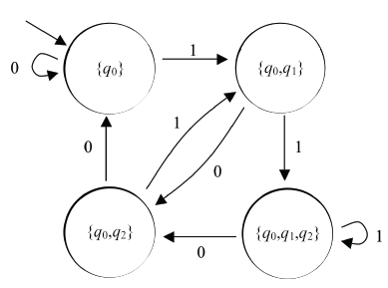
NFA to FA

Slide 85
NFA to FA
• It only remains to choose the accepting states
• An NFA accepts x if its set of possible states
after reading x includes at least one accepting
state
• So our DFA should accept in all sets that
contain at least one NFA accepting state

Slide 86
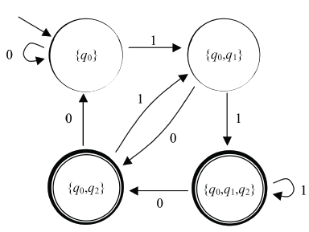
NFA to FA

